Slide 1


Building a diagnostic picture of asthma in primary care: Development of a novel jigsaw puzzle approach
Dermot Ryan, Janwillem Kocks, Jaime Correia de Sousa, Amanda Barnard, Siân Williams,

Slide 2
What is a jigsaw (puzzle)?
Why did we do it?
How did we do it?
What it is
What next?
Worked example
Order of the talk:

Slide 3

What is a jig-saw puzzle?
CREATING ORDER……
…………FROM CHAOS

Slide 4
What did we do?
We produced a short, accessible, comprehensible aid
reflecting medical practice and locally adaptable,
to facilitate and enhance clinical reasoning.

Slide 5

Why did we do it?
making a diagnosis is a critical achievement
if the diagnosis is incorrect, patients receive
the wrong treatment
If the diagnosis is wrong, patients will not
receive the correct treatment
current guidelines are complex and confusing ¹
there is a great educational need
2
Cabana MD, Rand CS, Powe NR, et al. Why don’t physicians follow clinical practice guidelines? JAMA 1999; 282: 1458–1465
Ryan D et al. Results of an allergy educational needs questionnaire for primary care. Allergy. 2017 Jul;72(7):1123-28. doi: 10.1111/all.13134
A different approach is needed

Slide 6

Current level of Asthma control In Primary Care
Well Contolled | 20%
Partially controlled | 34.8%
Uncontrolled | 45.1%
Prim Care Resp Med 24, 14009 (2014).
https://doi.org/10.1038/npjpcrm.2014.9

Slide 7
Overdiagnosis is common
Asthma overdiagnosis
Reevaluation of diagnosis in adults with physician-diagnosed asthma
Multicentre cohort study, enrolling 701 randomly selected adults with physician-diagnosed asthma in the previous five years
Findings:
  current asthma was excluded in 33% of the 613 participants who completed the study
  28% asymptomatic
  25% rhinitis
Asthma Diagnostic
Consultation Service
Referred with Asthma n=644
Confirmed asthma n=277
No asthma n=338
Diagnoses rhinitis n=99
GERD n=55
post infectious cough n=54
smokers cough n=15
Non pulmonary diagnosis n=39
GP referral
Definite asthma
43
Asthma 17
No Airway Narrowing 11
Restrictive 9
Other 6
62% not asthma
GP Referral
Suspected asthma
99
33% not asthma
Asthma 11
No Airway Narrrowing 70
88% not asthma
55% not asthma
Restrictive 7
COPD 2
Other 9
Aaron SD et al. JAMA 2017; 317(3): 269–279.
Gillis et al. PCRJ 2017
Starren et al PCRJ, 2012

Slide 8
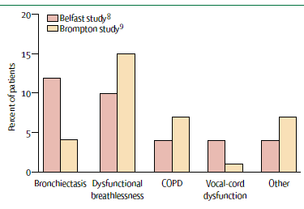
Over-diagnosis
in Tertiary Care ≅ 30%
Lancet 2005;365:974-76

Slide 9
Great Educational Need
Ryan D et al. Results of an allergy educational needs questionnaire for primary care. Allergy. 2017 Jul;72(7):1123-28. doi: 10.1111/all.13134.

Slide 10
Why do we need a different approach?
•
The diagnosis of asthma is not always straight forward
The initial diagnosis of asthma is based on
  the combination of presence of characteristic symptoms (cough, dyspnea, chest tightness, night-waking and wheeze),
  demonstration of airflow limitation and variability
Diagnostic errors arise because:
  day to day variability of symptoms and the numerous phenotypes of disease
  Reliance on a single diagnostic symptom e.g.cough
  failure to confirm reversible airflow obstruction,
  poor sensitivity of spirometry alone to confirm asthma

Slide 11

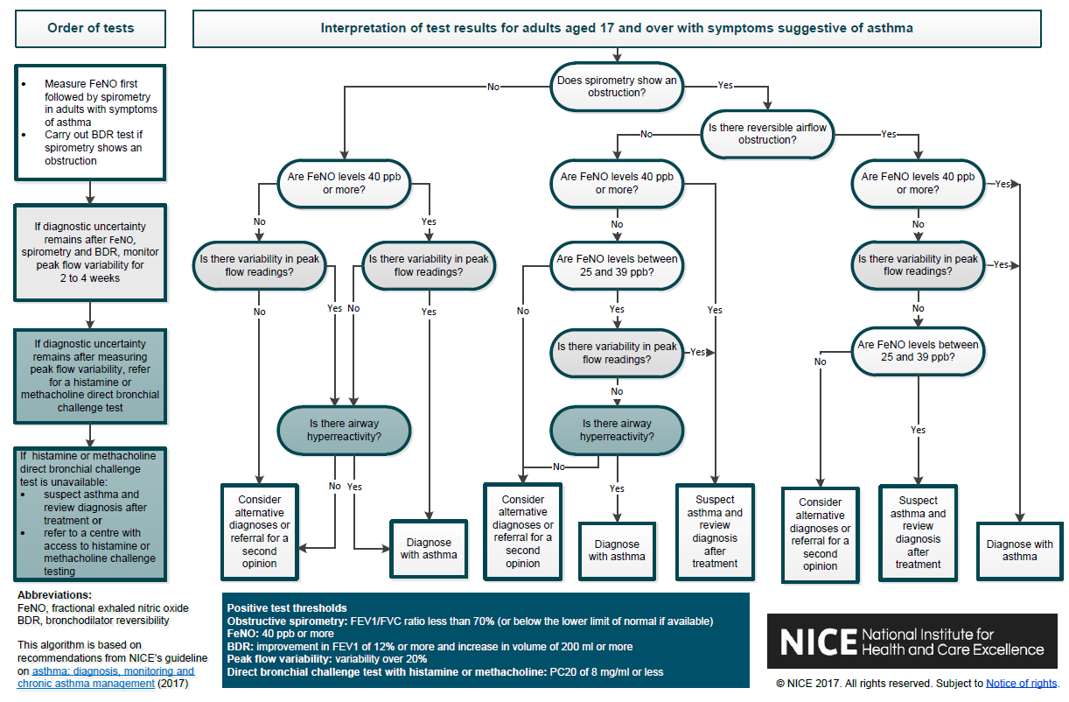
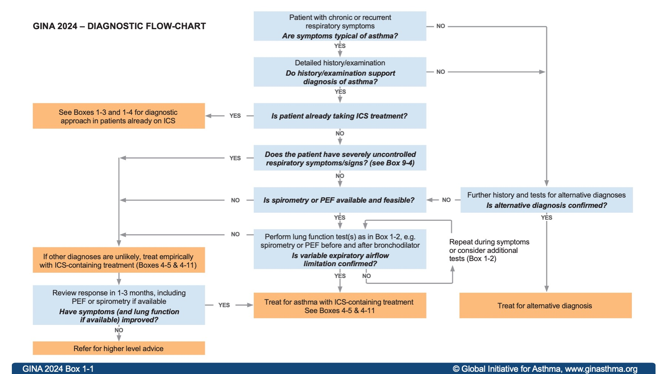
Current guidelines create complexity and confusion
GINA 2024
NICE, UK, 2017

Slide 12
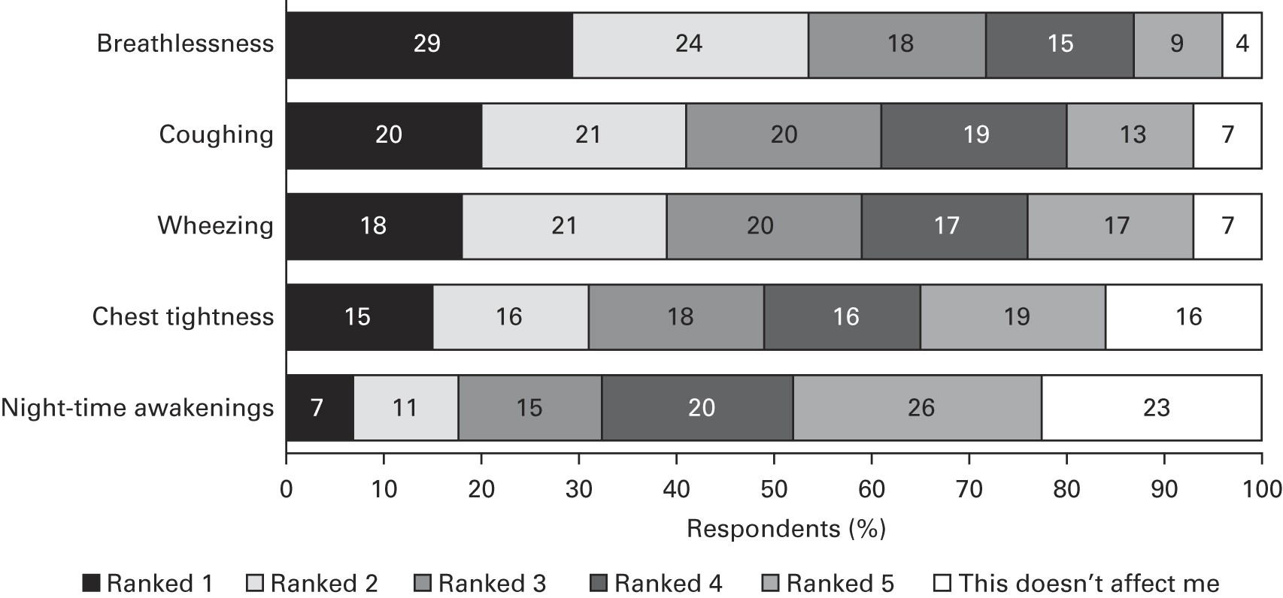
Individual symptom priority n=8000
Note: not everyone
has all symptoms
symptom combinations are critical
Prim Care Resp Med 24, 14009 (2014). https://doi.org/10.1038/npjpcrm.2014.9
Notes:
Price, D., Fletcher, M. & van der Molen, T. Asthma control and management in 8,000 European patients: the REcognise Asthma and LInk to Symptoms and Experience (REALISE) survey. npj Prim Care Resp Med 24, 14009 (2014). https://doi.org/10.1038/npjpcrm.2014.9

Slide 13
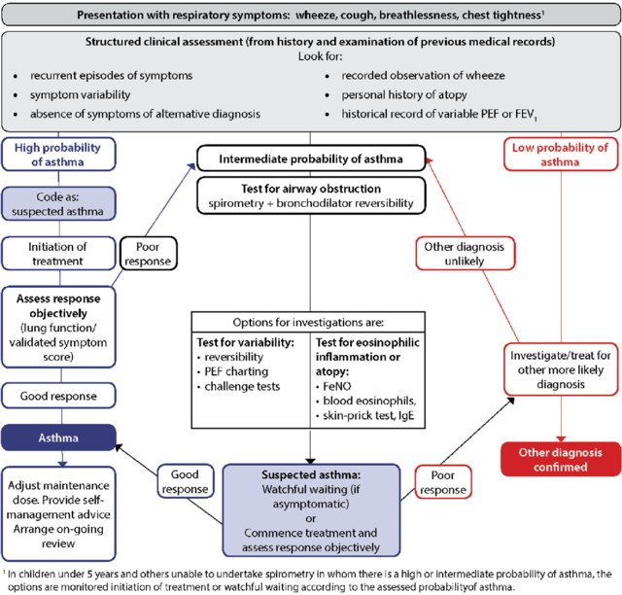
SIGN/BTS Guideline: stratifies
Presentation with respiratory symptoms: wheeze, cough, shortness of breath, chest tightness
Structured clinical assessment from history, examination and PMH
Look for
recurrent episodes
symptom availability
No suggestion of alternative diagnosis
Recorded observed wheeze
Personal Hx of atopy
Previous LFTs (in notes)
Highly likely to be asthma
Possblity of asthma
Asthma unlikely
Notes:
note prioritization of probability

Slide 14

Information (Puzzle Pieces) is/are presented without structure
….randomly thrown
Viral infection
Response
to treatment
Passive
smoking
Birth eg prematurity
Adherence
Sx
Tight
chest
Nocturnal
Hobbies
Salicylate hypersensitivity
Exercise
intolerance
Cough
Occupation
Reversibility
Eczema
Exercise
Sx
Tobacco depen
dence
Eosinphilia
Hayfever
FeNO
Family
history
Allergic
sensitis- ation
Fatigue
Rhinitis
Wheeze
Atopy
Notes:
https://www.clipartmax.com/download/m2H7G6H7A0K9b1i8_jigsaw-puzzles-template-coloring-book-puzzle-video-jigsaw-puzzle/

Slide 15

How did we do it?
How did we fit it together?
Viral infection
Tight
chest
Birth eg prematurity
Salicylate hypersensitivity
Exercise
Sx
Tobacco depen
dence
Hayfever

Slide 16



We held a half-day ‘puzzle’ workshop
Four working groups (international) in two rounds negotiated and categorised jigsaw pieces most relevant for building a clinical picture of asthma
Presentation
Symptoms and
physical examination
History
Objective tests
https://www.youtube.com/watch?v=jguPHc8XHDE

Slide 17
Our aims were:
1 Use a (jigsaw) puzzle as an analogy for building a picture over time, which better represents clinical practice
2. Describe the process of defining the format and content of this approach with
the aim of improving the quality of asthma diagnosis in primary care and
to use in IPCRG education work (Desktop Helper)

Slide 18

In reality, patients present many complex
pieces of information (puzzle pieces)
http://www.jigzone.com/puzzles/BA055D4CF4A2

Slide 19
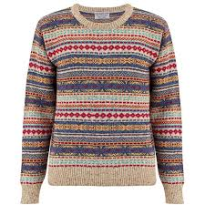


How do we make sense of this?

Slide 20
Defining the content for asthma diagnosis
Presentation
Symptoms and physical examination
History
Objective tests
Why has the person come to see you?
Ask about symptoms & conduct physical exam
Personal and family
Airway dysfunction,
Biomarkers
These factors and their relative importance may differ at national level
BD, bronchodilator.

Slide 21
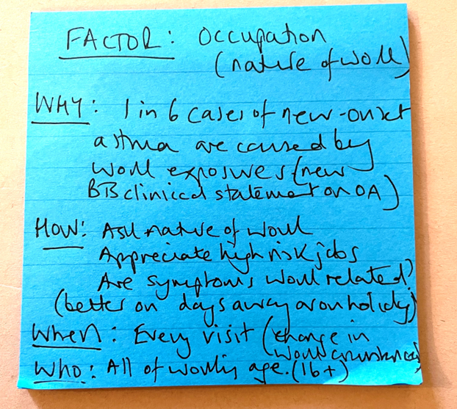
Puzzle piece: Occupation (example)
Each group was asked to suggest pieces using this format
WHY? | How will it influence decision-making?
HOW? | How will you elicit it? (question, test, observation, other); How will you interpret the answer? How will you code it?
WHEN? | When would you ask? (first consultation, subsequent, every time, once…)
WHO? | All, child, adult, sub-group?

Slide 22
Defining the content for asthma diagnosis
Presentation
Symptoms and physical examination
History
Objective tests
Why has the person come to see you?
Examples:
Tight chest
Wheeze
Cough
‘Infection’
Breathless
Chest pain
Ask about symptoms & conduct physical exam
Examples:
Wheeze
Night-time symptoms
Fatigue
Exercise intolerance
Personal and family
Examples:
Atopy
Smoking
Hobbies
Rhinitis
Past medical History
Airway dysfunction,
Biomarkers
Examples:
Spirometry with reversibility
Serial peak flow
Microspirometry
Other: FeNO, biomarkers
Occupation
These items are not exhaustive
BD, bronchodilator.

Slide 23

Using the jigsaw metaphor ….
Symptoms and
Physical examination
Presentation
Allocating puzzle piece to each of the domains
(“corner pieces”) as it is acquired
History
Objective tests

Slide 24
Some people prefer starting with the corners ….
Symptoms and
Physical examination
Presentation
Building the picture or assembling the information,
problem solving approach
History
Objective tests

Slide 25

Even if not all the clinical signs and symptoms are present, the diagnosis may be obvious
Highly likely to be asthma

Slide 26



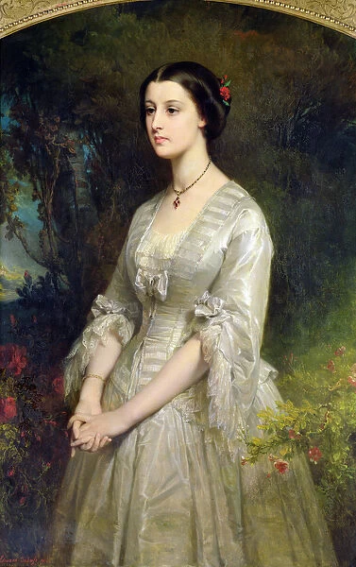
Some clinical signs and symptoms might not fit in the overall picture
Pieces which do not fit
should prompt a search for
another picture/
alternative diagnosis
Haemoptysis
Paraesthesia
Asthma unlikely

Slide 27

Now we are fairly sure….
? something missing ?
Possiblity of asthma

Slide 28

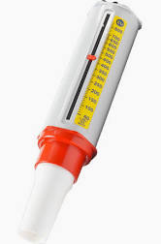
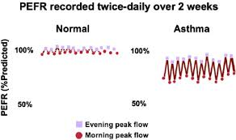
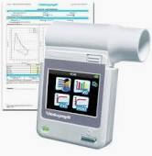
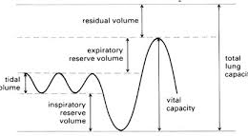
Now we have the whole picture
Evidence of airways dysfunction

Slide 29

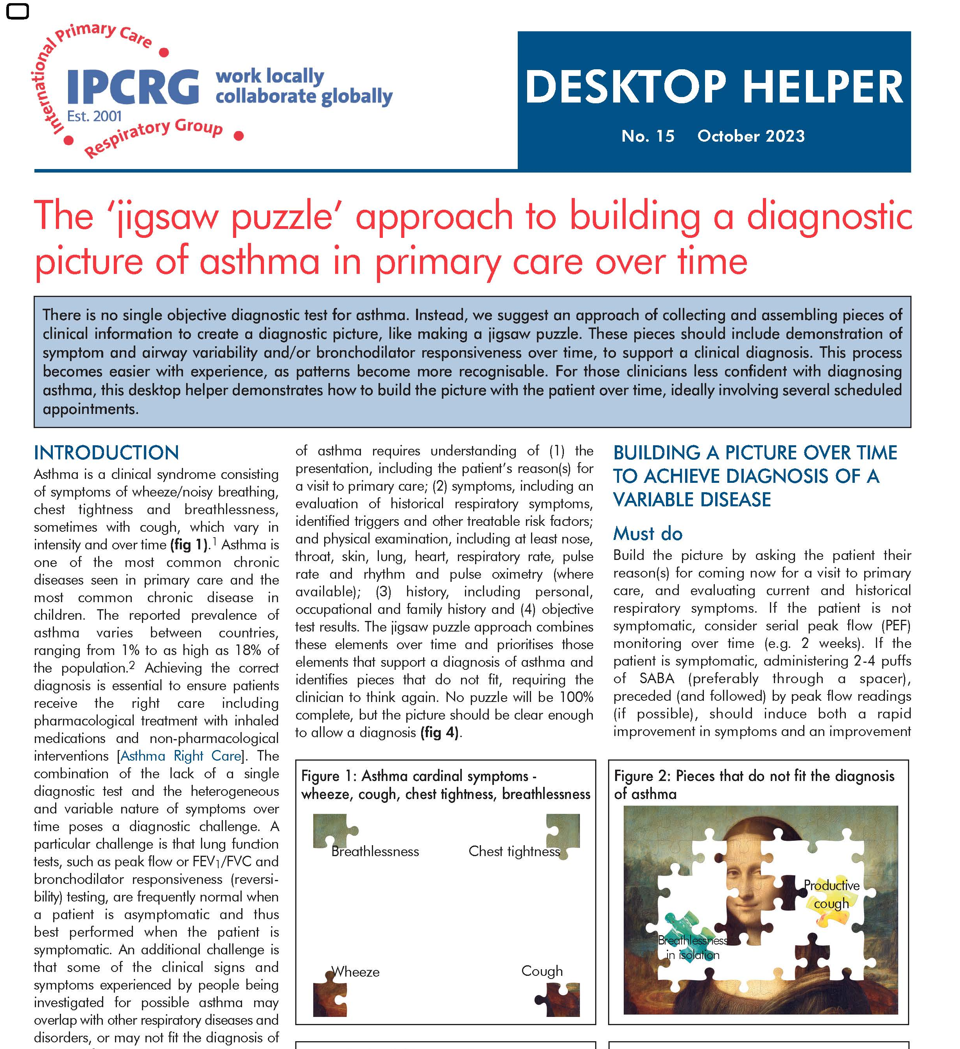

available at:
https://www.ipcrg.org/DTH15

Slide 30
Summary: developing a teaching and learning tool to support asthma diagnosis
The asthma (jigsaw) puzzle is a new teaching and learning strategy- it is not comprehensive
Created using a context-specific problem-solving diagnostic process reinforcing pattern recognition
Enables primary care practitioners to visualize the clinical picture and decide on the likelihood of an asthma diagnosis
Further tools are being developed using the puzzle metaphor

Slide 31
Case : John is a 21 year old man
“ Please may I have some more salbutamol? As many as you can give me. I've had asthma for many years”
He has symptoms of cough, wheeze, SoB on exertion tight chest and wakes most nights
He has: never been admitted to hospital for asthma, but has had several ED presentations – treated with oral steroids current hay fever/allergic rhinitis eczema as a child never smoked works as a delivery driver rarely socializes, no hobbies anxious chest clear pulse 76
PEFR 580 (exp 620)
Viral infection
Response
to treatment
Passive
smoking
Sx
Birth eg prematurity
Tight
chest
Nocturnal
Hobbies
Reversibility
Salicylate hypersensitivity
Cough
Exercise
intolerance
Eczema
Occupation
Adherence
Exercise
Sx
Fatigue
Eosinphilia
FeNO
Family
history
Tobacco depen
dence
Hayfever
Allergic
sensitis- ation
Rhinitis
Atopy
Wheeze

Slide 32





Symptoms
physical examination
Presentation
History
Objective tests

Slide 33

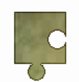

So, what do you think?
History
His mother has eczema as did he as a child.
Was never admitted to hospital but has a course of oral steroids at A+E most years.
He is nervous.
He works for a delivery company
He is a never smoker
No hobbies,
Rarely socialises
John
Presentation
John is a 21 year old man
First consultation: Please may have some more Salbutamol?
As many as you can give me
I have had asthma for many years
Symptoms and physical examination
He has symptoms of cough, wheeze, SoB on exertion, tight chest and wakes most nights
He takes Salbutamol 20puffs daily
He has current hay fever.
Objectively
His Peak flow is 580 (exp 620)
Pulse rate 76
His chest is clear
Notes:
ERS Task force: European Respiratory Society Guidelines for the Diagnosis of Asthma in Adults
Recommendation • The TF suggests not recording PEF variability as the primary test to make a diagnosis of asthma diagnosis (conditional recommendation against the test, low quality of evidence) Remarks • PEF may be considered if no other lung function test is available including spirometry at rest and bronchial challenge testing • PEF should be monitored over a two--week period and a variation of >20% considered as supportive of asthma diagnosis • PEF variability

Slide 34

What supports a diagnosis of
asthma?
symptoms of cough, wheeze, SoB on exertion,
tight chest and night waking; current allergic rhinitis.
What pieces are missing?
His mother has eczema
…as did he as a child.
No physical signs
no objective evidence
What might you do next?
Seek objective evidence
Notes:
Symptoms
Past history
Maternal history
No evidence of airways ddysfunction
normal physical exam
Serial peak flows
eosinophil count
Feno
Spirometry with reversibility
Specific IgE

Slide 35
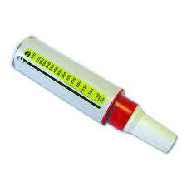
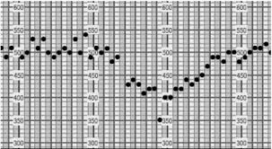

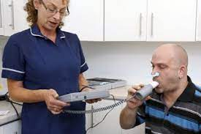
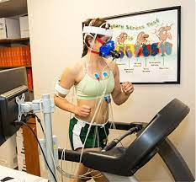
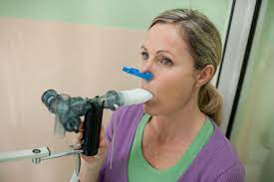

Tests of Airways function
Comments
Easy and available
Strong recommendation, weak evidence.
A normal test does not exclude asthma.
Possible to carry out informally in primary care.
Frequently used in specialist care when diagnosis is difficult
Serial Peak flows:
Spirometry with reversibility
Exercise tolerance test
Bronchoprovocation (methacholine, mannitol)
-Lung function tests are best carried out when the patient is symptomatic or untreated
- diurnal variation in lung function
Notes:
An exercise challenge test (ECT) is a non-obtrusive, real-life test that provides patients, caregivers and medical professionals more insight into the predominant cause(s) of exertional dyspnea. An ECT is an indirect bronchoprovocation test assessing bronchial hyperreactivity to exercise. Subjects perform a submaximal effort during 4–6 min, attempting to provoke recognizable symptoms (48). Lung function is measured at baseline, post-exercise and post-salbutamol. EIB is diagnosed when exercise results in a fall in FEV1 (or FEV0.5) of ≥ 13–15% post-exercise compared to baseline (31). Indirect challenge tests trigger airway narrowing through activation of the endogenous inflammatory pathways involved in asthma. Direct bronchoprovocation challenges (e.g., methacholine) do not activate these pathways but act directly on the airway smooth muscle receptor. They are generally more sensitive but less specific than indirect bronchoprovocation challenges (49, 50). An advantage of an ECT compared to other direct and indirect tests is the possibility to identify other causes of exertional dyspnea besides EIB during one test (19, 51). Figure 1 visualizes the steps and points of attention during the phases of an ECT.

Slide 36
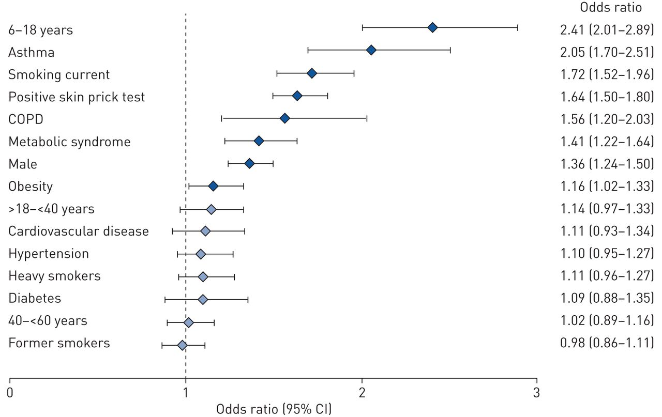
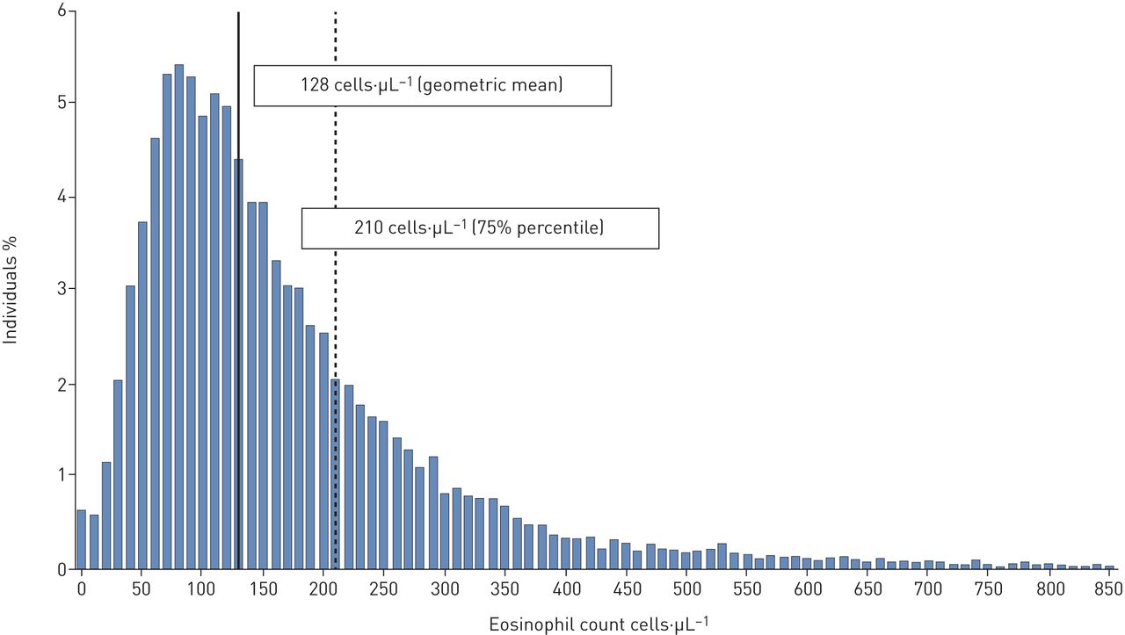
Supporting investigations: Blood Eosinophil Count
128 cells per µL (mean)
201 cells per µL 75th centile
Odds ratio of association with high BEC: >201
Distibrution of BEC values in population (n=11K)
European Respiratory Journal 2020 55: 1901874; DOI: 10.1183/13993003.01874-2019
Notes:
Blood eosinophil count in the general population: typical values and potential confounders
Sylvia Hartl, Marie-Kathrin Breyer, Otto C. Burghuber, Alina Ofenheimer, Andrea Schrott, Matthias H. Urban, Alvar Agusti, Michael Studnicka, Emiel F.M. Wouters, Robab Breyer-Kohansal
European Respiratory Journal 2020 55: 1901874; DOI: 10.1183/13993003.01874-2019

Slide 37
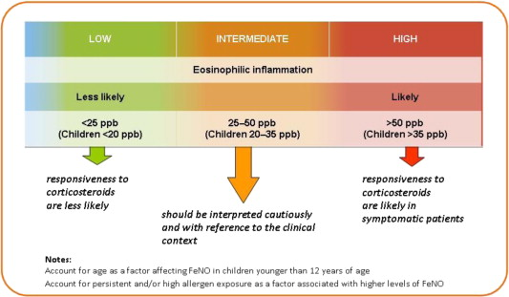
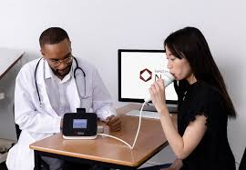
Cut off levels for FeNO
Supporting investigations: Fractional exhaled nitic oxide (FeNO)
Factors Suppressing FeNO:
Smoking, alcohol and caffeine
Inhaled steroids
Factors increasing FeNO:
Green leafy vegetables,
lettuce, broccoli, beetroot…

Slide 38
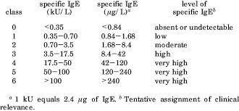
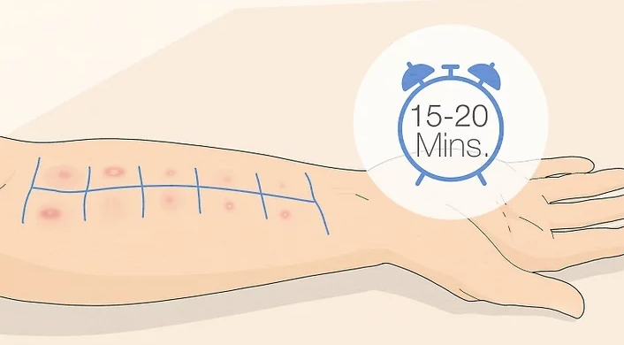
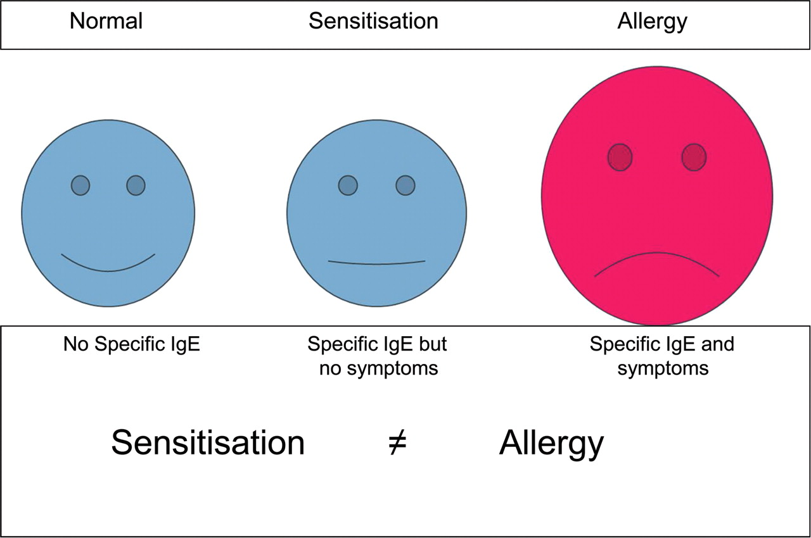
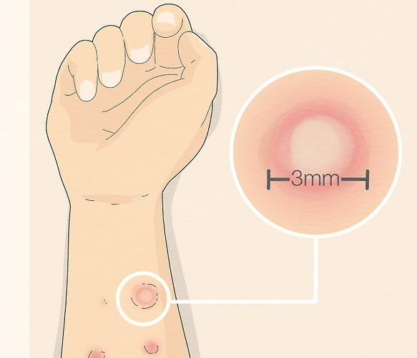
Supporting investigations: specific IgE (SIgE)
skin prick testing
Serum
SPT

Slide 39
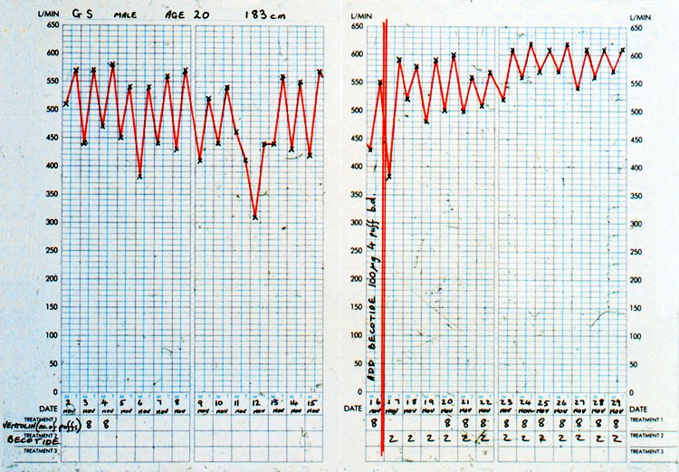
……find some more pieces
Note marked diurnal variation
Note evening readings
0–14% variability | Uncharacteristic of asthma
15–19% variability | Supports diagnosis of asthma
20–30% variability | Mild persistent asthma
31–100% variability | Moderate to severe persistent
26% variability
48% variability
PEF𝑚−PEF𝑒
0.5 (PEF𝑚+PEF𝑒)×100
Commence ICS
Teach and check inhaler technique
Notes:
Kunzli N, Stutz EZ, Perruchoud AP, Brandli O, Tschopp JM, Bolognini G, Karrer W, Schindler C, Ackermann-Liebrich U, Leuenberger P. Peak flow variability in the SAPALDIA study and its validity in screening for asthma-related conditions. American Journal of Respiratory and Critical Care Medicine. 1999 Aug 1;160(2):427-34.
Burge PS, o'Brien IM, Harries MG. Peak flow rate records in the diagnosis of occupational asthma due to colophony. Thorax. 1979 Jun 1;34(3):308-16.
Cross D, Nelson HS. The role of the peak flow meter in the diagnosis and management of asthma. Journal of allergy and clinical immunology. 1991 Jan 1;87(1):120-8.

Slide 40



Slide 41
Two week follow-up: response to treatment
6% variability
Note response to treatment
GINA 2022:
a significant response to treatment after 4W.
FEV1> 12% or 200ml
PEF >20%
Notes:
ERS Task force: European Respiratory Society Guidelines for the Diagnosis of Asthma in Adults
Recommendation • The TF suggests not recording PEF variability as the primary test to make a diagnosis of asthma diagnosis (conditional recommendation against the test, low quality of evidence) Remarks • PEF may be considered if no other lung function test is available including spirometry at rest and bronchial challenge testing • PEF should be monitored over a two--week period and a variation of >20% considered as supportive of asthma diagnosis • PEF variability

Slide 42

Building the jigsaw over time
History
His mother has eczema as did he as a child.
Was never admitted to hospital but has a course of oral steroids at A+E most years.
He is nervous.
He works for a delivery company
He is a never smoker
No hobbies,
Rarely socialises
Presentation
First consultation: Please may have some more Salbutamol?
As many as you can give me
I have had asthma for many years
Symptoms and physical examination
John is a 21 year old man
He has symptoms of cough, wheeze, SoB on exertion, tight chest and wakes most nights
He takes Salbutamol 20puffs daily
He has hay fever.
.
Objectively
His Peak flow is 580 (exp 620)
Pulse rate 76
His chest is clear
Airway variability over time
Response to treatment
Notes:
ERS Task force: European Respiratory Society Guidelines for the Diagnosis of Asthma in Adults
Recommendation • The TF suggests not recording PEF variability as the primary test to make a diagnosis of asthma diagnosis (conditional recommendation against the test, low quality of evidence) Remarks • PEF may be considered if no other lung function test is available including spirometry at rest and bronchial challenge testing • PEF should be monitored over a two--week period and a variation of >20% considered as supportive of asthma diagnosis • PEF variability

Slide 43




