Slide 1
Understanding Lung Cancer: Risk Factors and the Importance of Early Detection
PHARM. GERALD OBINNA OZOTA

Slide 2
Table of Content
Introduction
Function of the Lungs
Etiology of Lungs
Types of Lung Cancer
Prevalence of lung Cancer
Warning signs and symptoms
Screening and Early Detection
Reducing the Risk
Conclusion

Slide 3
The Lungs
The lungs are the primary organs of the respiratory system in many animals. They pull air into your body so your tissues can get oxygen.
There are two lungs in the human body, a right and a left. Many people think of them like balloons. But they’re actually made up of spongy tissue, airways (tubes that air travels through), air sacs (alveoli), and blood vessels. The blood vessels pick up oxygen from the air sacs and deliver it to the rest of your body.

Slide 4
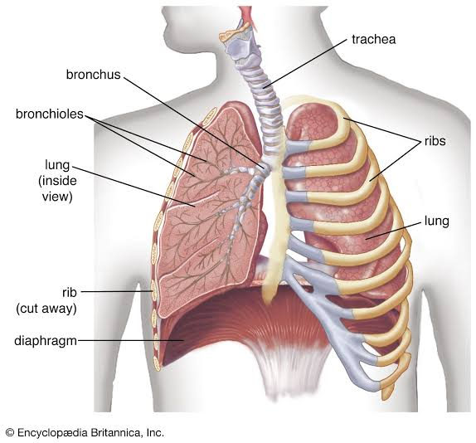

Slide 5
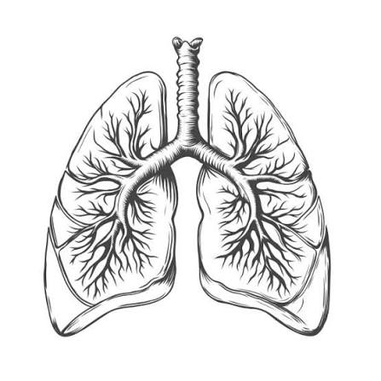
Function of the lungs
Oxygen delivery: Oxygen passes through the thin walls of the alveoli into surrounding blood vessels, where red blood cells carry it to the rest of the body.
Waste removal: Carbon dioxide moves from your blood into the alveoli so you can breathe it out
Air conditioning: They warm and moisturize the air you breathe before it reaches your inner tissues.
Protection: Tiny hairs (cilia) and sticky liquid (mucus) trap dust and germs so you can cough or sneeze them out.
Support: They provide the airflow needed to speak.

Slide 6
Etiology of Cancer
Lung cancer is caused by damage to the DNA inside lung cells, which makes them grow out of control and form tumors. These cancerous cells can damage healthy lung tissue and may spread to lymph nodes or other parts of the body.
There are 2 types of Lung cancer

Slide 7
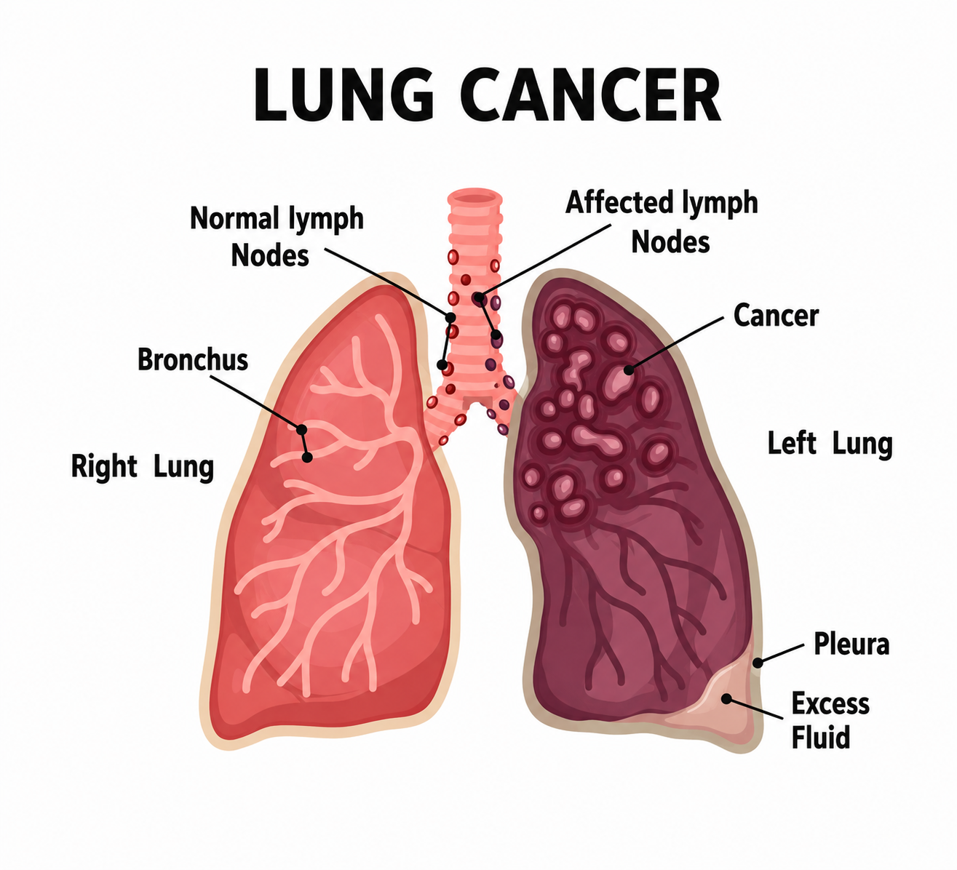

Slide 8
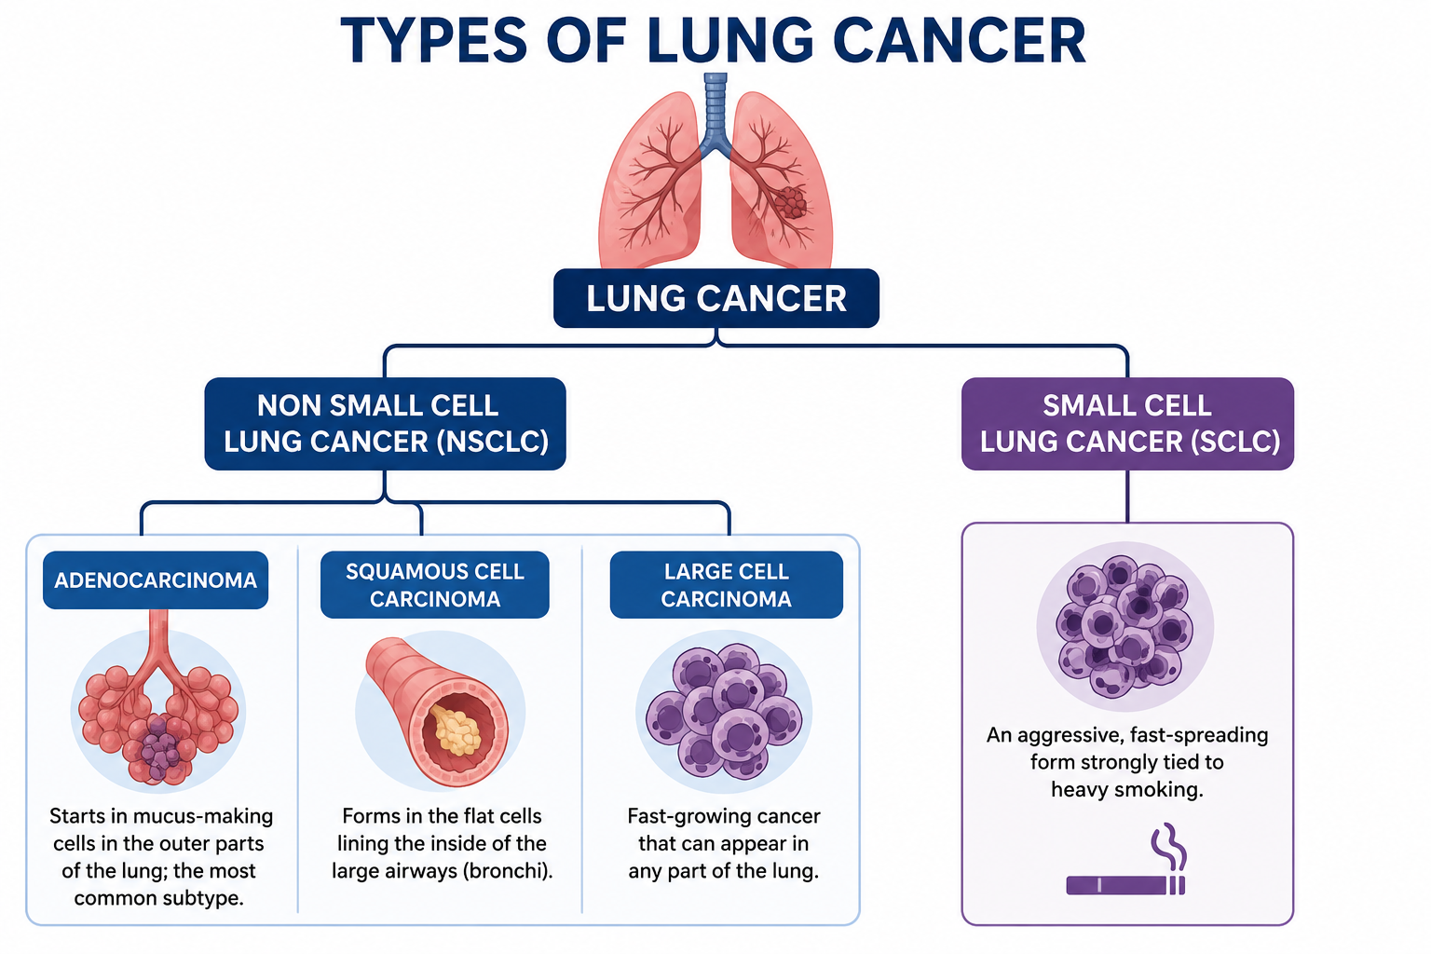

Slide 9
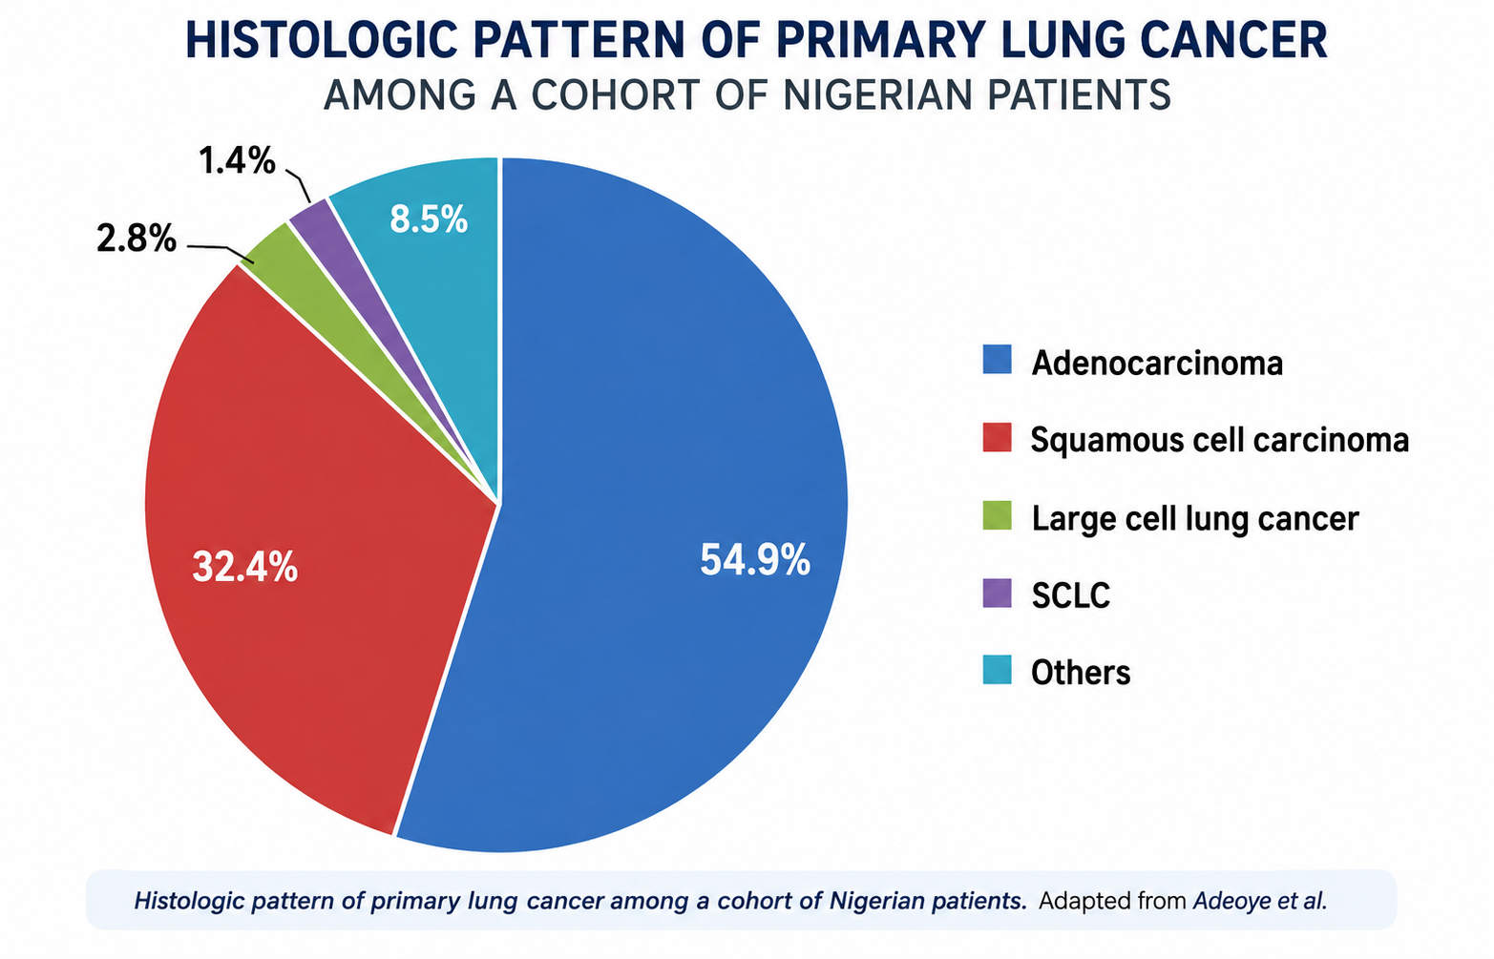

Slide 10
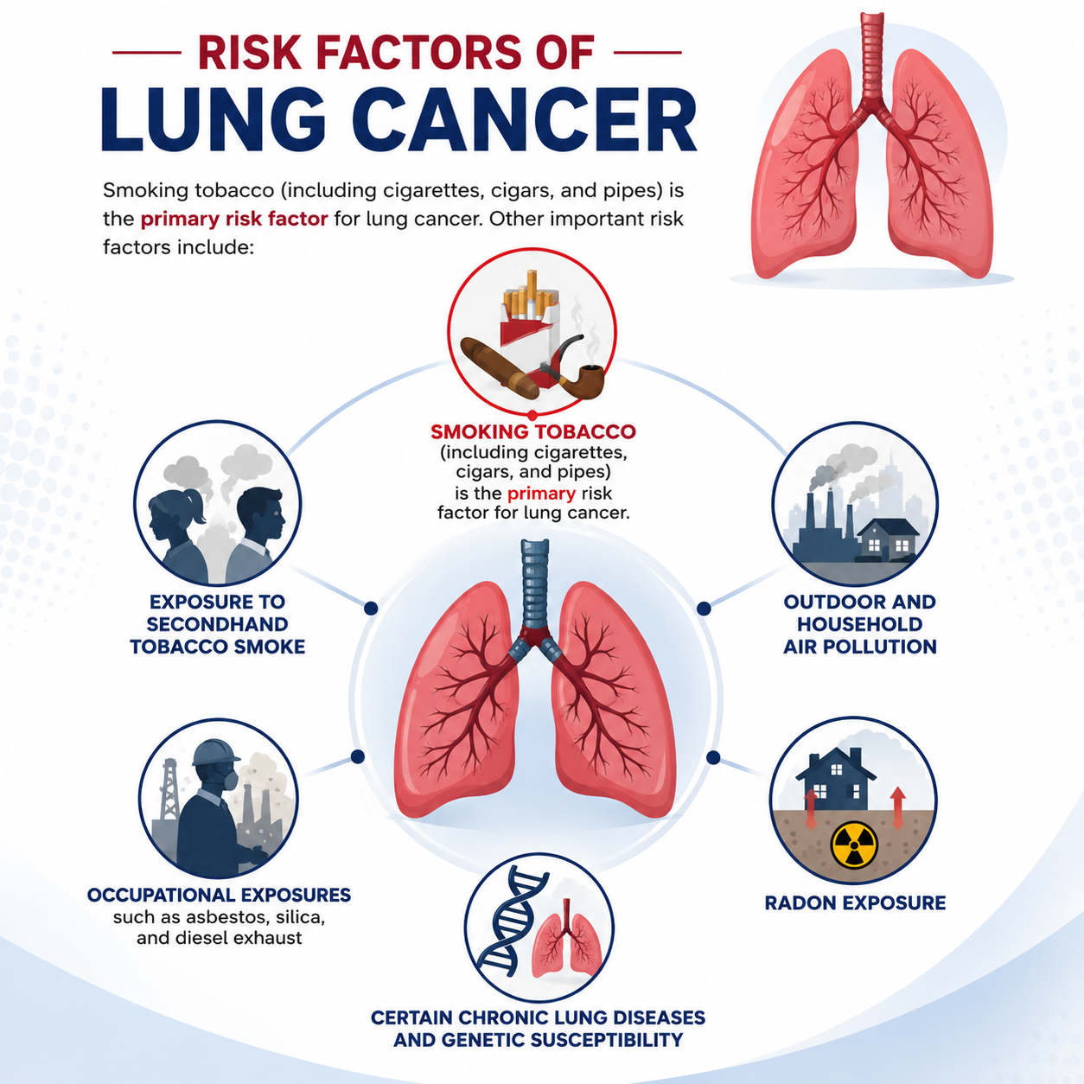

Slide 11
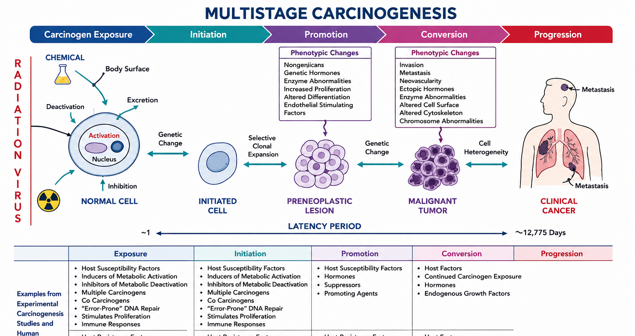

Slide 12
Prevalence of Lung Cancer
Globally, lung cancer remains a major public-health challenge. In 2022, approximately 2.5 million people were diagnosed with the disease, and more than 1.8 million people died from it.
The American Cancer Society’s estimates for lung cancer in the US for 2026 are:
  About 229,410 new cases of lung cancer (110,910 in men and 118,500 in women)
  About 124,990 deaths from lung cancer (63,040 in men and 61,950 in women)

Slide 13
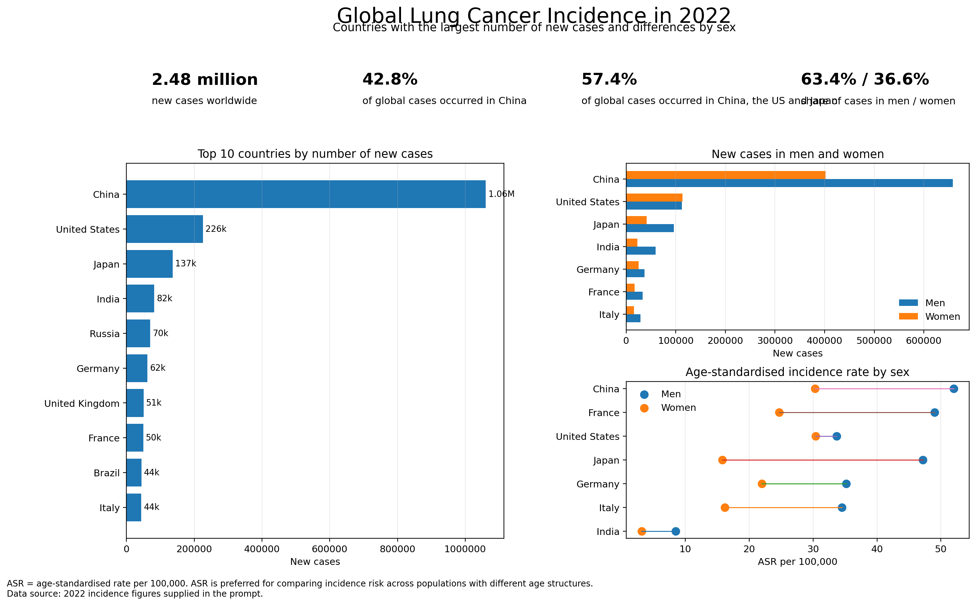

Slide 14
Prevalence of Lung Cancer
Lung cancer prevalence in Nigeria is low compared to global averages, estimated at roughly 1,789 new cases and 1,643 deaths annually. It ranks 14th among cancer types in the country, though experts note that actual numbers are likely under-reported due to diagnostic limitations.
In general, about 13% of all lung cancers are SCLC, and about 77% are NSCLC.

Slide 15
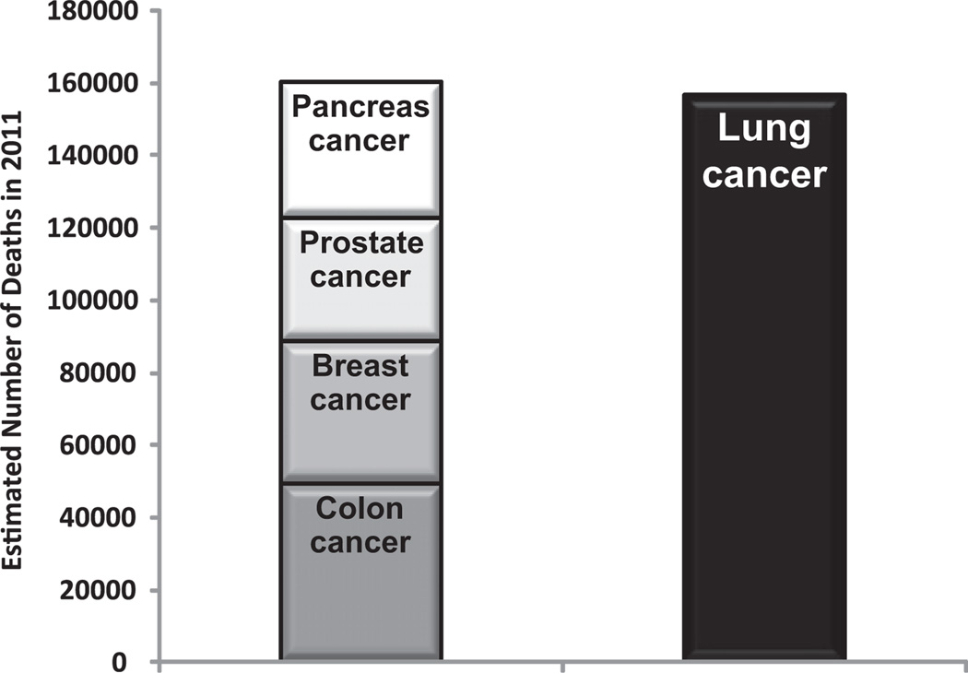
Prevalence of Lung Cancer
Lung cancer accounts for about 1 in 5 of all cancer deaths, with more mortality than breast, colon, and prostate cancers combined.

Slide 16
Problem Statement
A study among patients with lung cancer seen at a thoracic specialist practice in North-Central Nigeria found that most patients (82.7%) presented with stage III to IV primary lung cancers, with 56.3% having already developed malignant pleural effusion at the time of first presentation to a specialist at that major referral institution!!!!

Slide 17
Warning Signs and Symptoms
Lung cancer may not produce obvious symptoms during its earliest stages. When symptoms appear, they may initially be mistaken for a respiratory infection or another common condition.
  Possible warning signs include:
  A cough that does not go away or becomes worse;
  Coughing up blood;
  Persistent chest pain;
  Shortness of breath or wheezing;
  Repeated episodes of pneumonia or other lung infections;
  Unexplained weight loss;
  Loss of appetite; and
  Persistent fatigue or weakness.

Slide 18
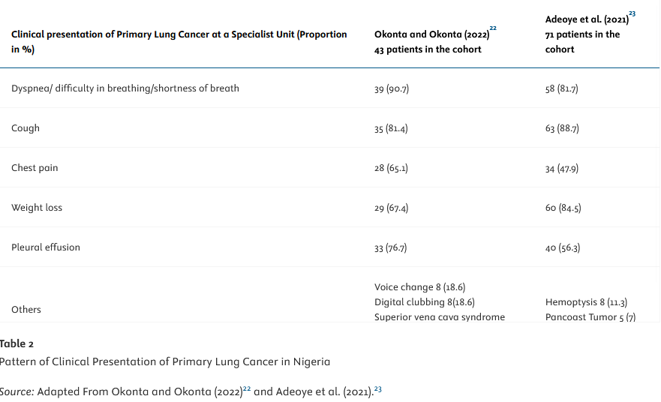

Slide 19
Problem Statement
According to the International Association for the Study of Lung Cancer (IASLC) By 2050, incidence and mortality rates are expected to rise by over 150%!!!

Slide 20
Screening and Early Detection
It is important to distinguish between screening and diagnostic evaluation. Screening is performed in people who do not have symptoms but are considered to be at high risk. A diagnostic evaluation is conducted when a person already has symptoms or an abnormal test result.
The recommended screening test is low-dose computed tomography, commonly called a low-dose CT or LDCT scan

Slide 21
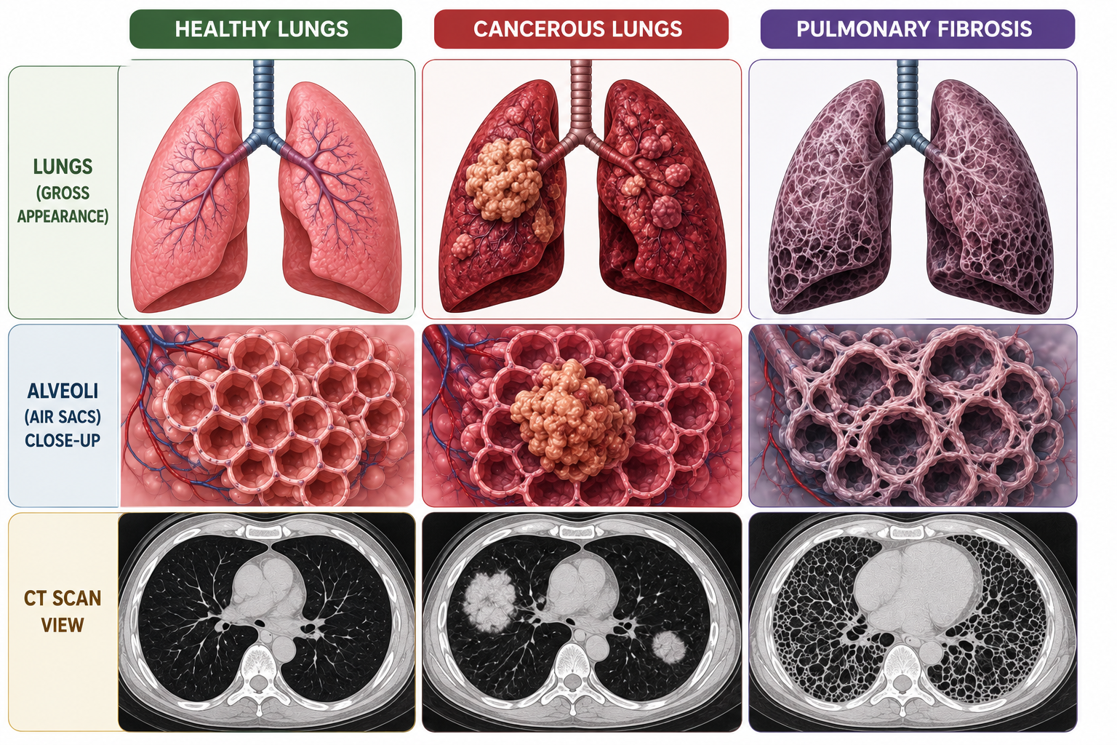

Slide 22
Screening and Early Detection
In the United States, annual LDCT screening is recommended for adults who:
  Are between 50 and 80 years old;
  Have at least a 20-pack-year smoking history; and
  Currently smoke or stopped smoking within the past 15 years.
  GOOD NEWS!!!
Early detection in lung cancer saves lives by dramatically increasing 5-year survival rates, offering more successful treatment options, and finding tumors before symptoms start. When caught at stage IA, the 5-year survival rate can exceed 90%, compared to less than 10% for stage IV.

Slide 23
Reducing the risk
AWARENESS!
AWARENESS!!
AWARENESS!!!

Slide 24
Reducing the risk
The most effective way to reduce lung cancer risk is not to begin smoking
For people who currently smoke, stopping remains beneficial regardless of how long they have smoked.
Maintaining smoke-free homes and vehicles, testing homes for radon where appropriate, following occupational safety procedures, using protective equipment around hazardous substances, and supporting policies that reduce tobacco exposure and air pollution.
Public education

Slide 25
Conclusion
The central message of World Lung Cancer Day is one of awareness, action and hope.
We must understand that lung cancer can affect people who smoke, people who previously smoked and people who have never smoked. We must recognize persistent warning signs, reduce exposure to preventable risks and encourage eligible individuals to speak with healthcare professionals about low-dose CT screening.

Slide 26
References
American Cancer Society. (2026, January 13). Key statistics for lung cancer. https://www.cancer.org/cancer/types/lung-cancer/about/key-statistics.html
Cleveland Clinic. (2026, March 6). Lungs: Location, anatomy, function, and complications. https://my.clevelandclinic.org/health/body/8960-lungs
Dela Cruz, C. S., Tanoue, L. T., & Matthay, R. A. (2011). Lung cancer: Epidemiology, etiology, and prevention. Clinics in Chest Medicine, 32(4), 605–644. https://doi.org/10.1016/j.ccm.2011.09.001
IASLC Global Policy and Partnerships Committee, Medhurst, E., Habashi, L., & Wheeler, E. (2025). Lung cancer care in Nigeria: How effective policy can transform outcomes. The Health Policy Partnership.
Okonta, K. E., Baiyewu, L. A., & Jimoh, M. A. (2023). Lung cancer in Nigeria. Journal of Thoracic Oncology, 18(11), 1446–1457. https://doi.org/10.1016/j.jtho.2023.08.022
World Health Organization. (2026, April 16). Lung cancer. https://www.who.int/news-room/fact-sheets/detail/lung-cancer

Slide 27

THANK YOU FOR LISTENING!!!

